Slide 1
CAS helping to bring
the IB Learner profile
into the IB Diploma
Bringing the new CAS guidelines
into focus

Slide 2
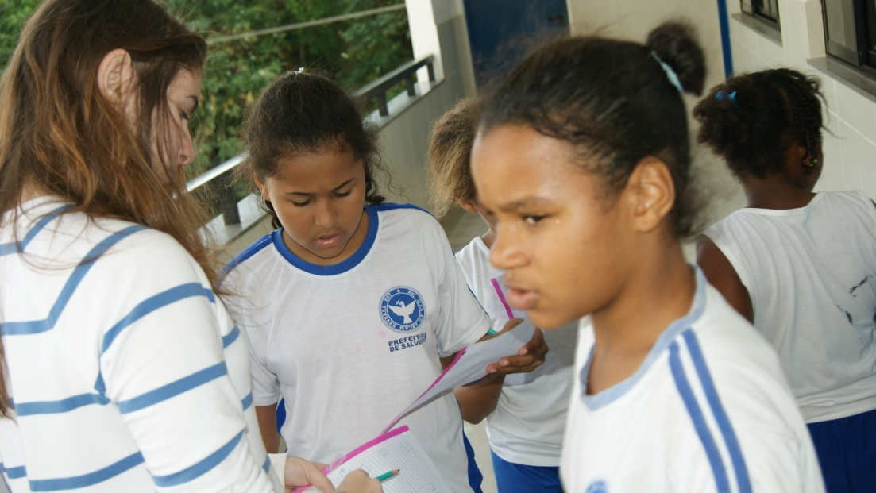
Aims of CAS
To provide for the personal development of the student

Slide 3
Aims of CAS
To help students to care about others less fortunate than themselves

Slide 4
Aims of CAS
To allow students to pursue individual interests as a distraction from the academic demands of the syllabus and have some fun….
To develop an awareness of other cultures

Slide 5
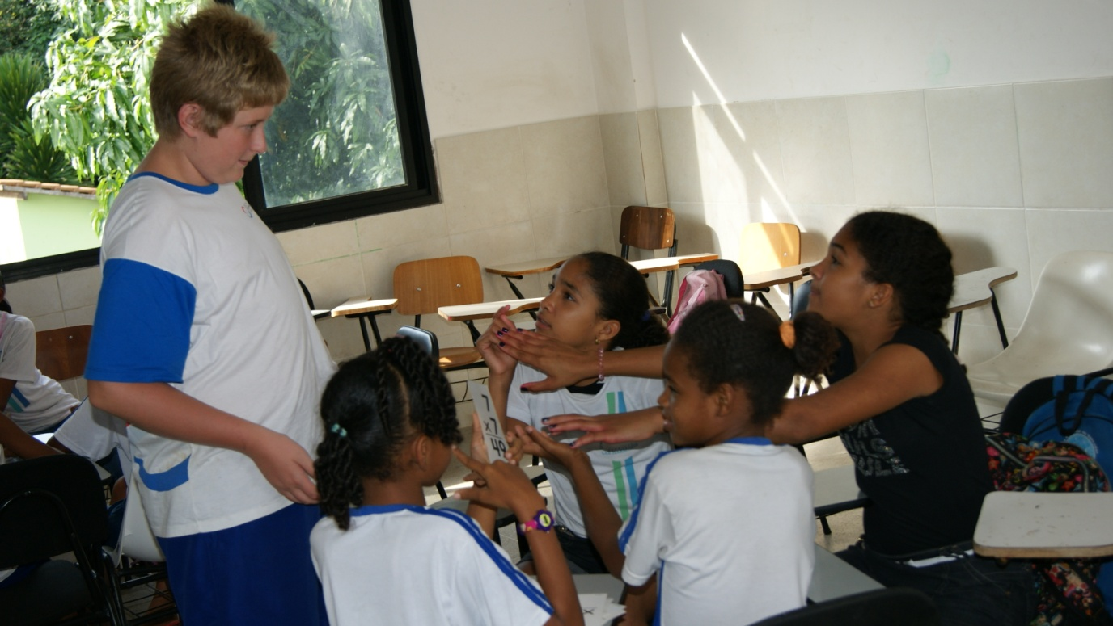
How are students going to do this?
Through the cycle of experiential education

Slide 6
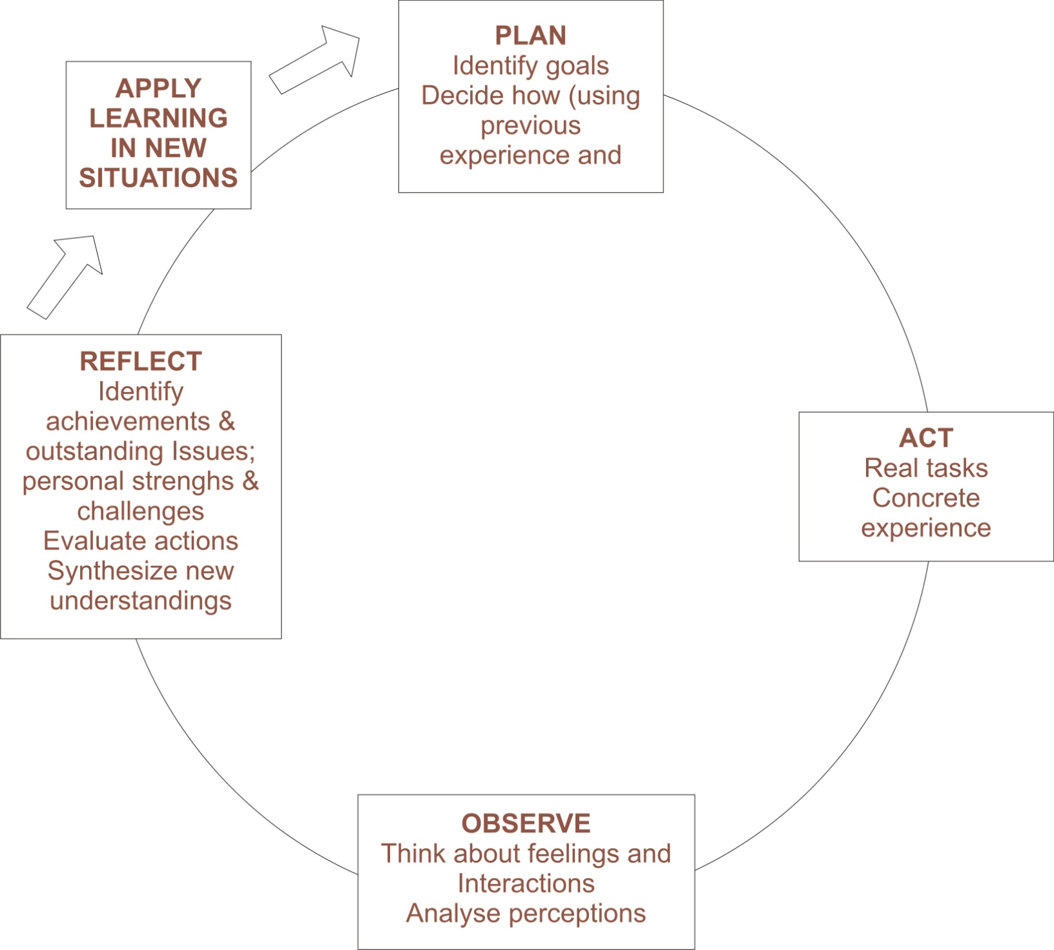

Slide 7
A piece of personal
experiential education
You have each been given a piece of paper
Now I want you to create something of beauty with your piece of paper. It could be…

Slide 8
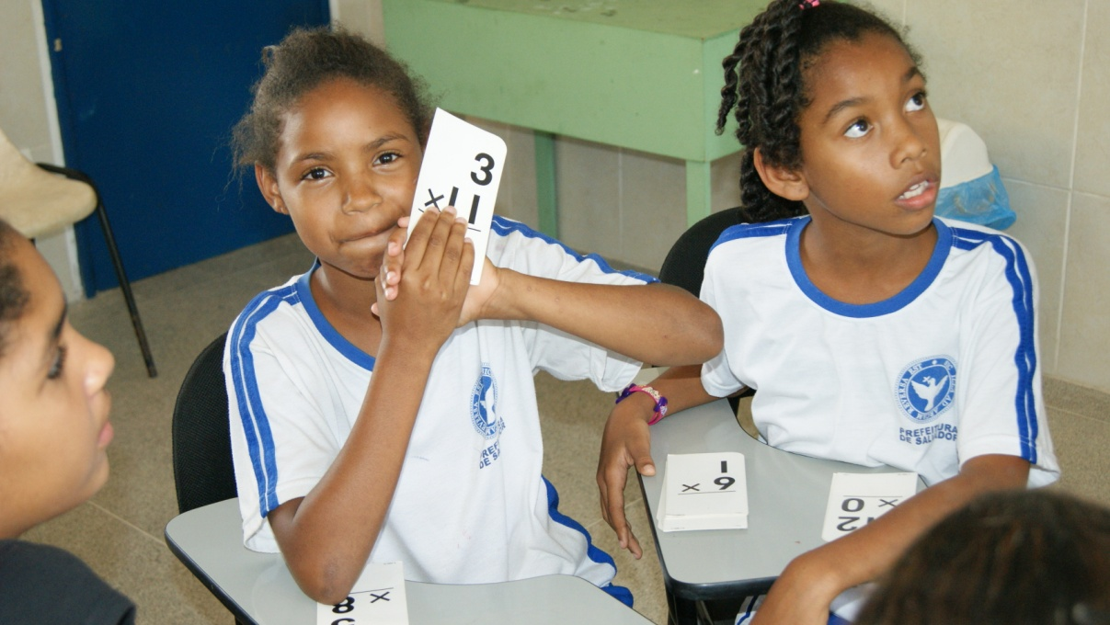
Please be prepared to share with your neighbor…
What your object of beauty is…
Why you think this is beautiful?

Slide 9
If you were given your time again
Would you have created the same thing?
What else could you have created?
This little exercise was an exercise in reflection a necessary part of any CAS experience

Slide 10
The new CAS guide encourages:
A wide range of challenging CAS activities
Quality reflections on the students experiences

Slide 11
Student responsibilities
Must do CAS for 18 months of the diploma program (should be a minimum of approximately 150 hours of activities)
Must keep a record of their reflections
Are expected to carry out at LEAST ONE CAS project in collaboration with other students that includes two or more areas of CAS

Slide 12
Student responsibilities
Self review at the start of the program
Set goals for the program
Plan, do and reflect on their activities
Meet with the CAS Adviser

Slide 13
What will be the characteristics of a good student CAS program?
Students will have meaningful reflections on their activities (the aim is for quality rather than quantity)
The students have carried out a CAS project (It has involved working with other students in 2 of the CAS areas)

Slide 14
A good student CAS program
The student has demonstrated 8 Learning outcomes through the entire CAS program.
(These outcomes are based on the IB Learner profile).

Slide 15
The Learning outcomes are…
Increased awareness of their own strengths and areas for growth.
(Derived from being Balanced and Inquirers)
Undertaken new challenges
(Derived from being a Risk taker)

Slide 16
Learning outcomes cont’d
Planned and initiated activities
(Derived from being Inquirers and Communicators)
Worked collaboratively with others
(Derived from being a communicator)

Slide 17
Student Learning Outcomes of CAS cont’d
Shown perseverance and commitment in their activities.
(Derived from Caring)
Engaged with issues of global importance
(Derived from Knowledgeable, Thinkers)

Slide 18
Student Learning Outcomes of CAS
Considered the ethical implications of their actions
(Derived from Open minded, Principled and Reflective)
Developed new skills
(Derived from Balanced)

Slide 19
How are we going to know if students have achieved these outcomes?
Watching the students carrying out their wide range of challenging activities.
Interviews with CAS advisers
(There are supposed to be 3 of these).

Slide 20
How are we going to know if the outcomes have been achieved ?
By seeing student reflections that may be in the form of:
Blogs, Power point presentations, Podcasts, Video/film, Diaries or journals

Slide 21
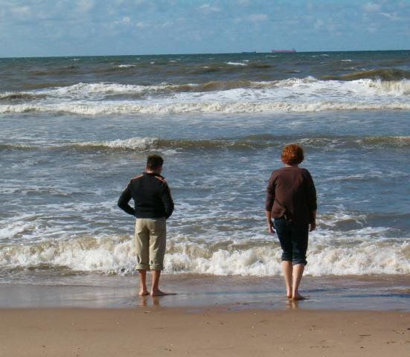
“All that we do is but a drop of water in the ocean. But if we didn’t contribute that drop there would be no ocean.” (Mother Theresa)

